Slide 1
Natural Language Processing, Deep Nets, Linear Algebra and Information Retrieval
Kenneth Church
Northeastern University
k.church@northeastern.edu
Wednesday, June 21

Slide 2
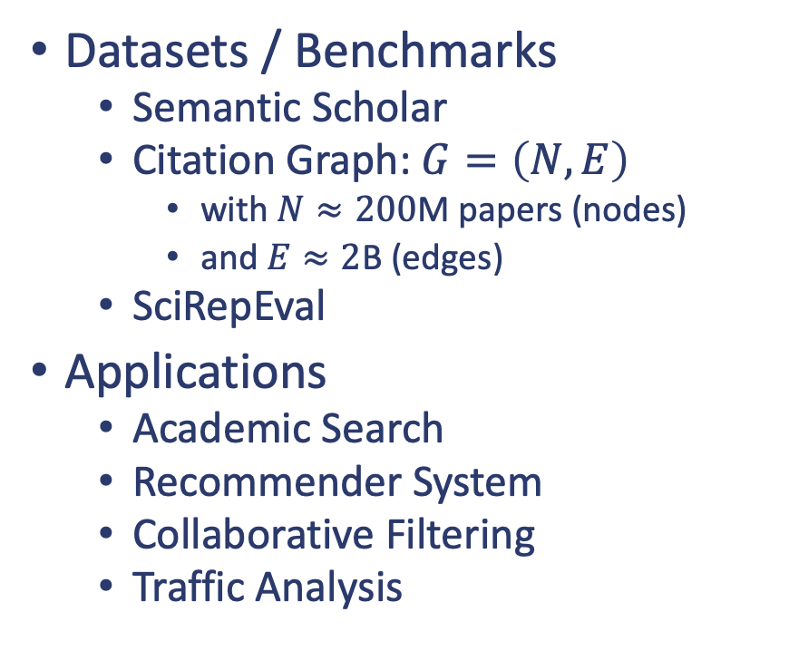
Introduction
Research Areas
Natural Language Processing (NLP)
Deep Nets (BERT)
Inference, Fine-tuning, Pretraining
Linear Algebra
Singular Value Decomposition (SVD)
Spectral Clustering
Information Retrieval (IR)
Datasets / Benchmarks
Semantic Scholar
Citation Graph: $G=\left(N, E\right)$
with $N≈200$M papers (nodes)
and $E≈2$B (edges)
SciRepEval
Applications
Academic Search
Recommender System
Collaborative Filtering
Traffic Analysis

Slide 3
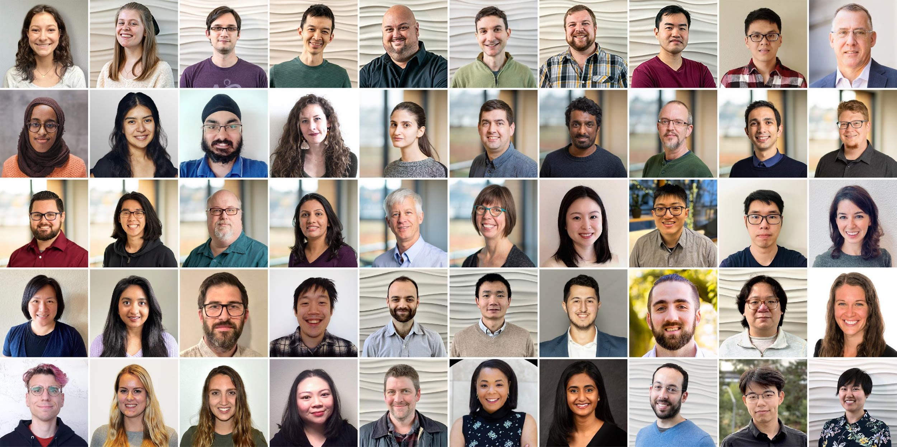
Semantic Scholar: Significant Effort (slide from Dan Weld)
50 person team
7 year project
207M+ scientific paper index
8M+ monthly active users

Slide 4
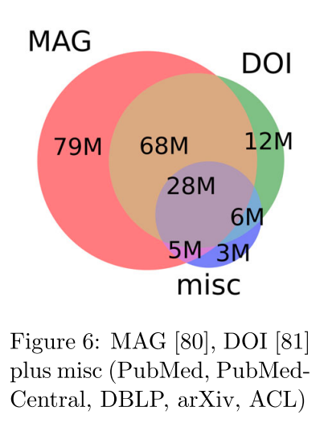
Semantic Scholar
Seven Sources
Fields of Study
Medicine (45M) | Engineering (8M) | Business (4M) | Geology (3M)
Chemistry (13M) | Physics (7M) | Sociology (3M) | History (2M)
Computer Science (13M) | Psychology (7M) | Geography (3M) | Art (2M)
Biology (13M) | Mathematics (5M) | Economics (3M) | Philosophy (1M)
Materials Science (10M) | Political Science (4M) | Environmental Science (3M)

Slide 5



Document Similarities: Use Cases
Recommendations
What should I read?
What should I cite?
Finding experts (who knows)
Similar to above, but answer is a contact (as opposed to a paper)
Routing submissions to reviewers
Features: titles, abstracts, full text, references
Summarization (of sets of documents):
Standard methods (e.g., tl;dr): summarize each doc, one at a time
Alternative: capture similarities & differences among clusters

Slide 6

Better Together: Text (Titles, Abstracts, Body); Context (Citations)

Slide 7
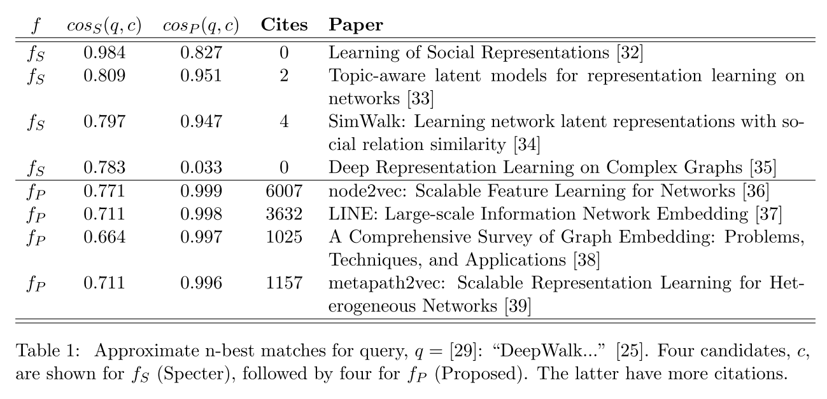
Query: ``DeepWalk: Online Learning of…’’

Slide 8
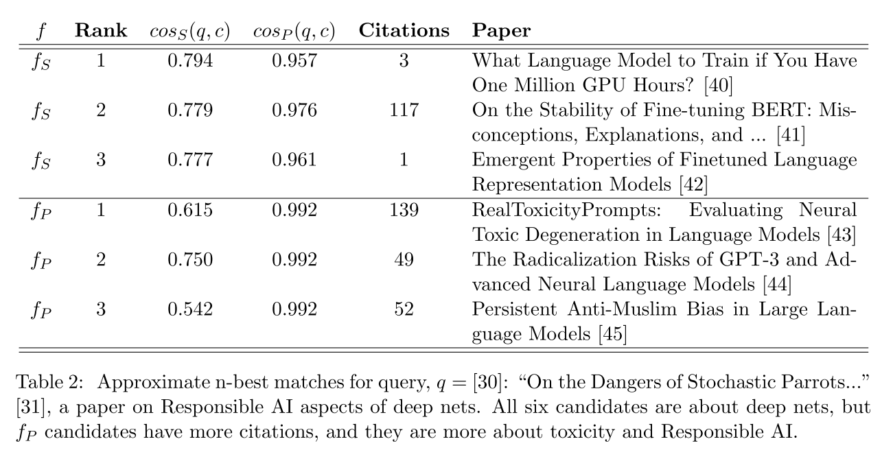
Query: ``On the Dangers of Stochastic Parrots…’’

Slide 9
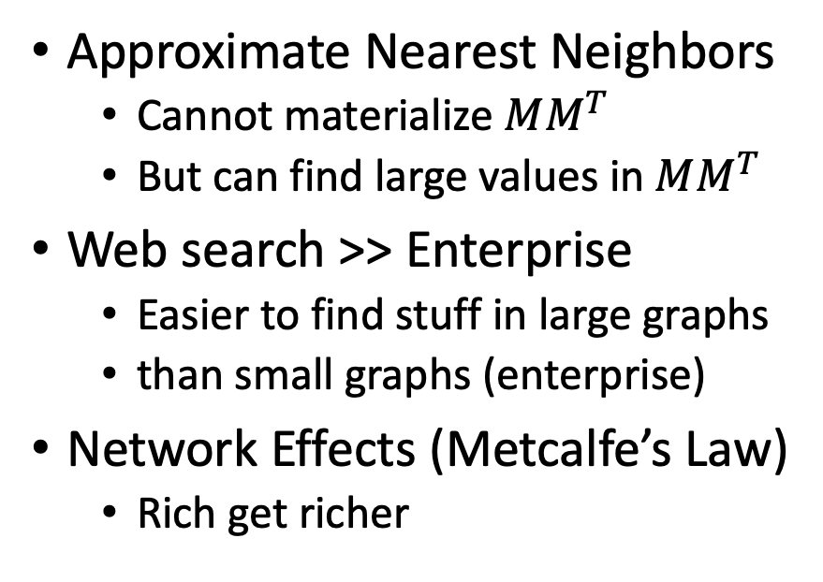
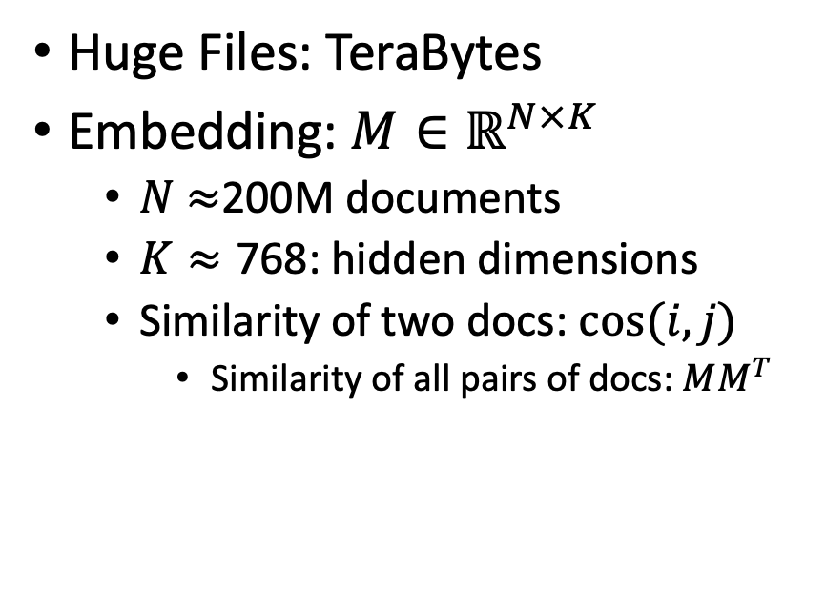
Scale
Curse
Blessing
Huge Files: TeraBytes
Embedding: $M∈ℝ^{N×K}$
$N$ $≈$200M documents
$K≈\text{768}$: hidden dimensions
Similarity of two docs: $cos(i,j)⁡$
Similarity of all pairs of docs: $MM^{T}$
Approximate Nearest Neighbors
Cannot materialize $MM^{T}$
But can find large values in $MM^{T}$
Web search >> Enterprise
Easier to find stuff in large graphs
than small graphs (enterprise)
Network Effects (Metcalfe’s Law)
Rich get richer

Slide 10

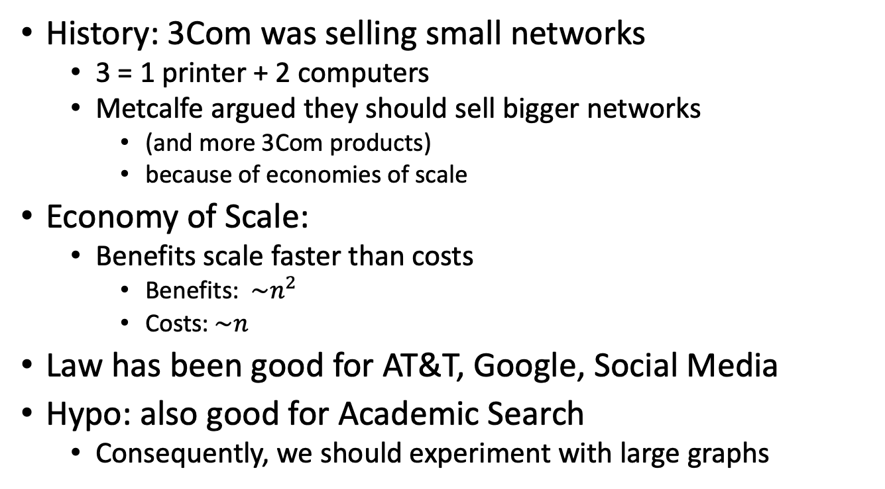
Metcalfe’s Law (Network Effects)
History: 3Com was selling small networks
3 = 1 printer + 2 computers
Metcalfe argued they should sell bigger networks
(and more 3Com products)
because of economies of scale
Economy of Scale:
Benefits scale faster than costs
Benefits: $\sim n^{2}$
Costs:$\sim n$
Law has been good for AT&T, Google, Social Media
Hypo: also good for Academic Search
Consequently, we should experiment with large graphs

Slide 11
Realities
The Real World
Idealizations (Evaluation Benchmarks)
Large (Metcalfe’s Law)
Growing
Dirty
Missing Values
Bad/misleading Values
Small
Static
Clean

Slide 12
Global Scientific Output Doubles Every 9 Years
Web companies keep indexes up to date (web is a moving target)
Ditto for Academic Search

Slide 13
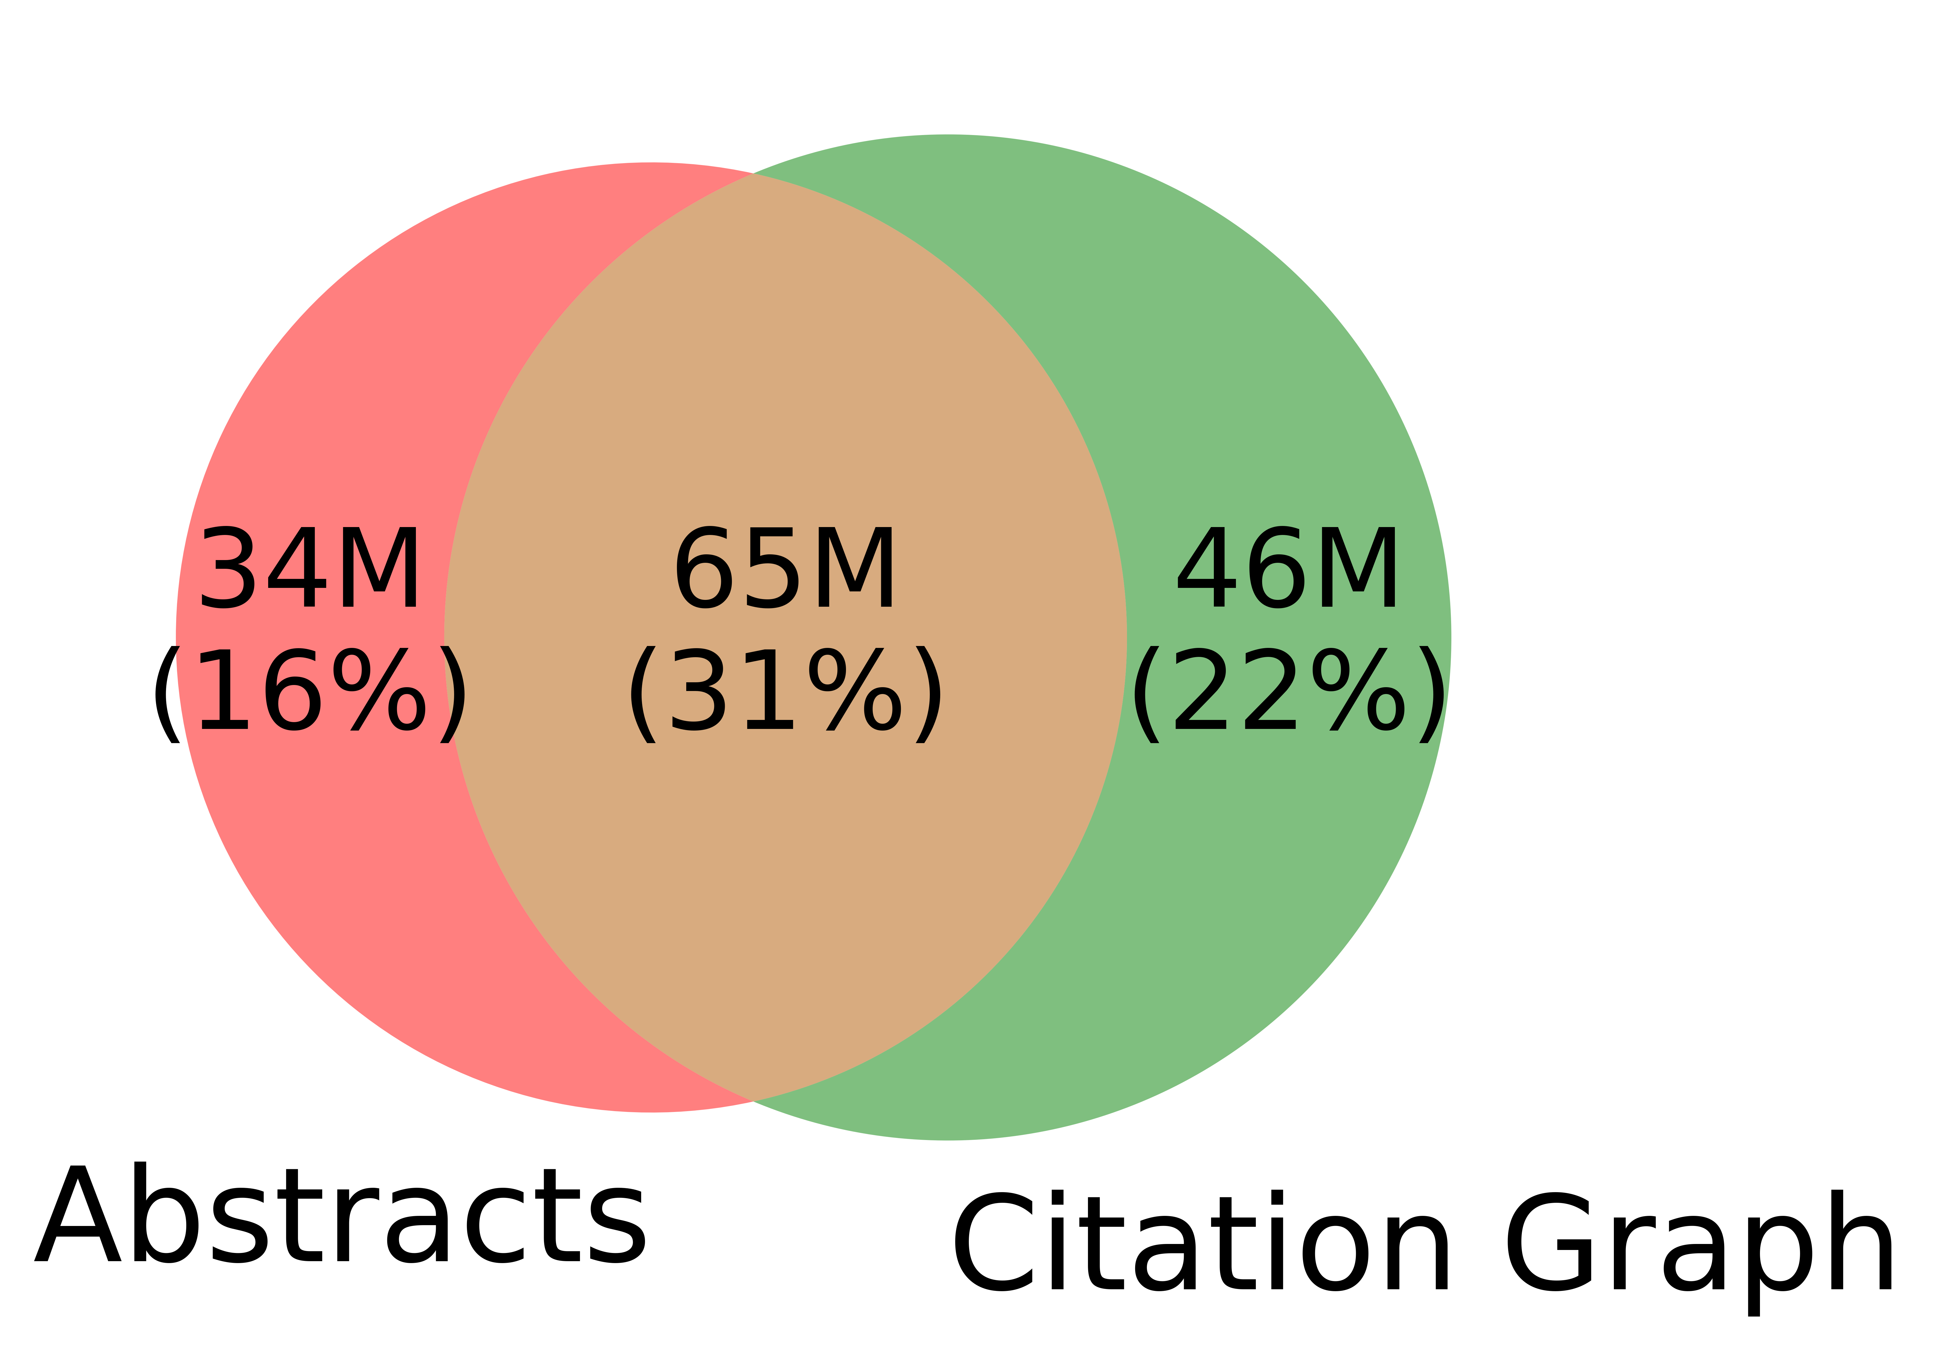
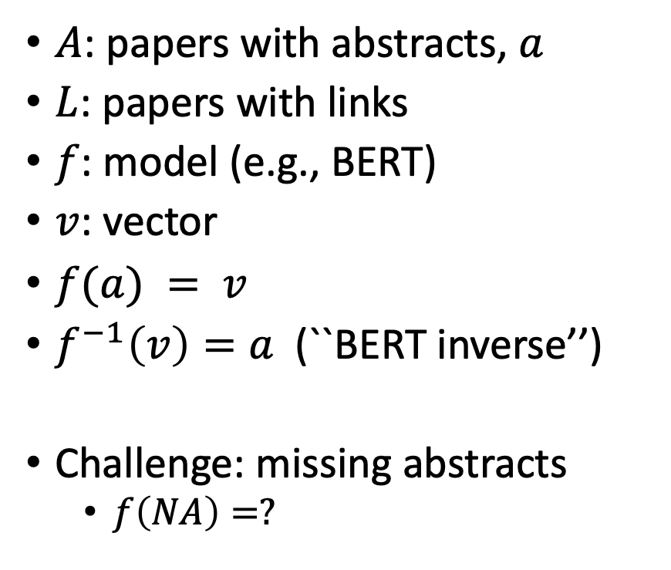
Realities: Missing Values
$A$: papers with abstracts, $a$
$L$: papers with links
$f$: model (e.g., BERT)
$v$: vector
$f(a) = v$
$f^{−1}\left(v\right)=a$(``BERT inverse’’)
Challenge: missing abstracts
$f\left(NA\right)=?$

Slide 14
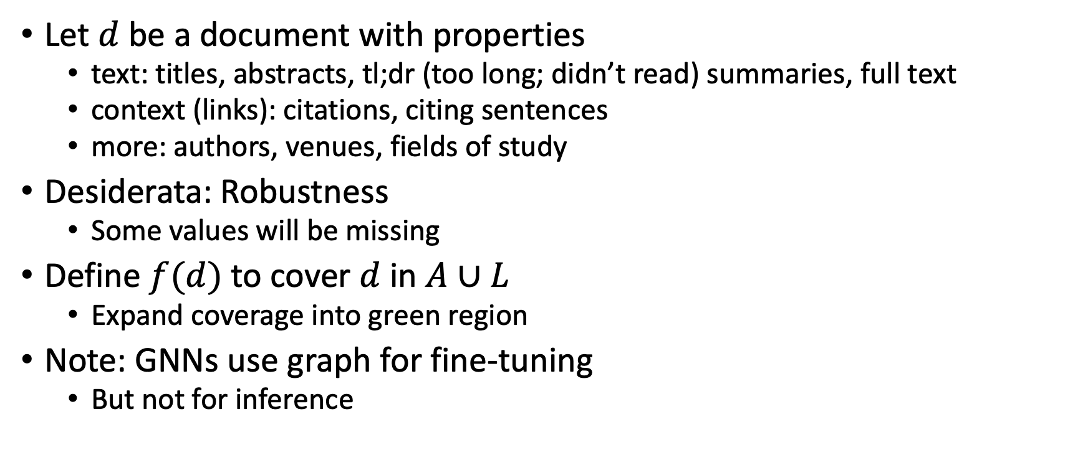
Suggestion for Missing Values
Let $d$ be a document with properties
text: titles, abstracts, tl;dr (too long; didn’t read) summaries, full text
context (links): citations, citing sentences
more: authors, venues, fields of study
Desiderata: Robustness
Some values will be missing
Define $f(d)$ to cover $d$ in $A∪L$
Expand coverage into green region
Note: GNNs use graph for fine-tuning
But not for inference

Slide 15
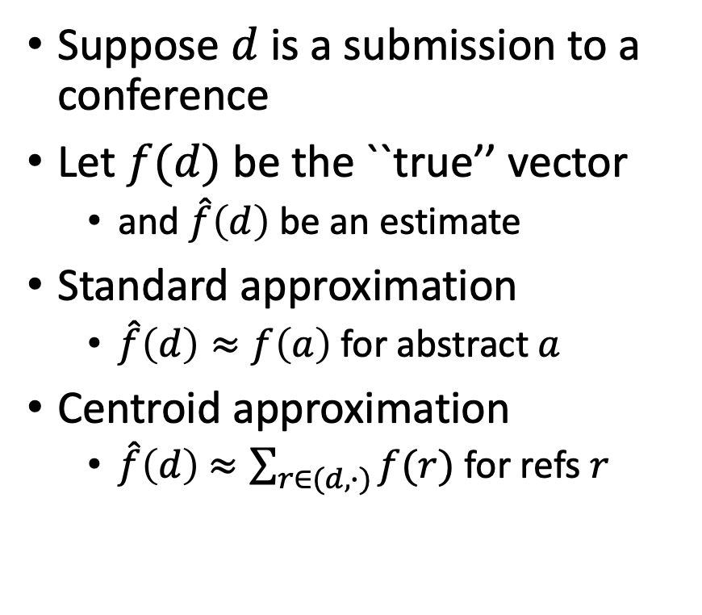
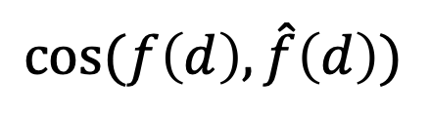
Centroid Assumption
Evidence for Centroid Approximation
Suppose $d$ is a submission to a conference
Let $f(d)$ be the ``true’’ vector
and $\hat{f}\left(d\right)$ be an estimate
Standard approximation
$\hat{f}\left(d\right)≈f\left(a\right)$ for abstract $a$
Centroid approximation
$\hat{f}\left(d\right)$ $≈\sum_{r∈(d,∙)}{f(r)}$ for refs $r$
$$cos⁡(f\left(d\right), \hat{f}\left(d\right))$$

Slide 16
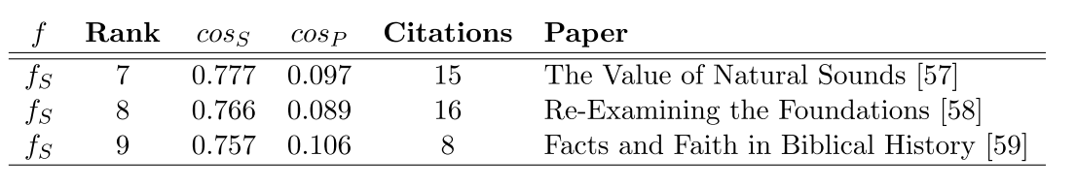
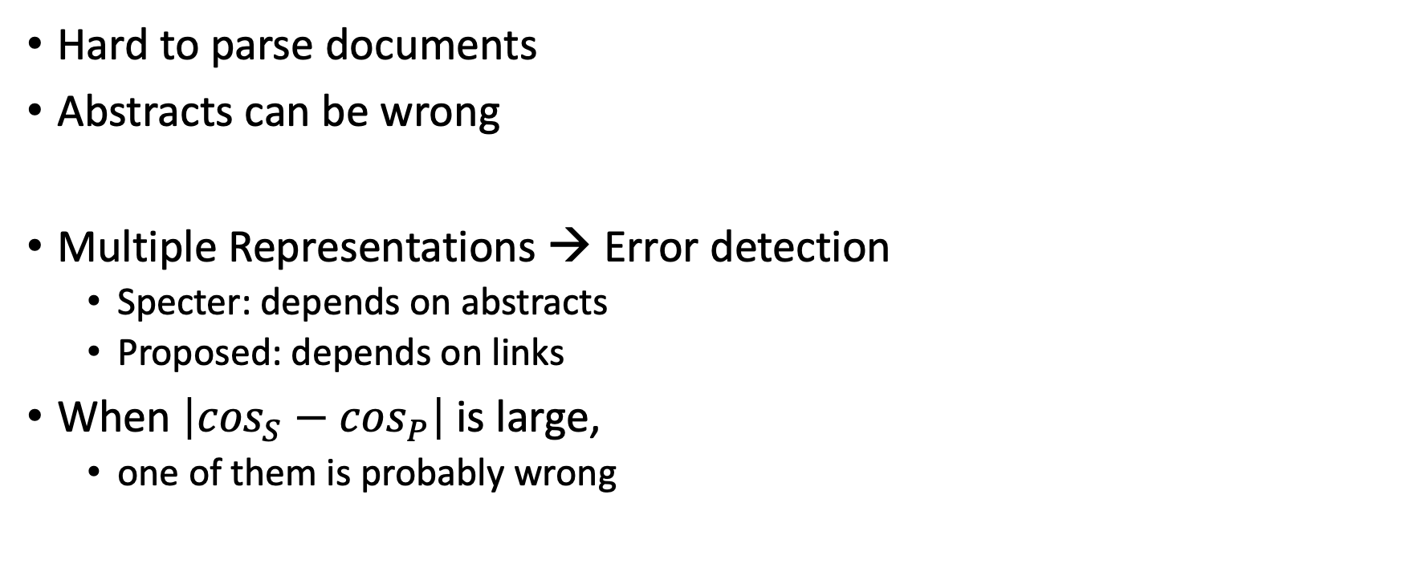
Bad/Misleading Values: Redundancy → Robustness
Hard to parse documents
Abstracts can be wrong
Multiple Representations → Error detection
Specter: depends on abstracts
Proposed: depends on links
When $\left|\cos_{S}−\cos_{P}\right|$is large,
one of them is probably wrong

Slide 17


Rank | Specter | Proposed | Paper
query | 1.000 | 1.000 | 1097: On stress and linguistic rhythm
1 | 0.908 | 0.926 | 0: Linguistic Society of America Structure and Intonation
2 | 0.895 | 0.977 | 475: Preliminaries to linguistic phonetics
3 | 0.885 | 0.921 | 25: Linguistic Society of America On the Definition of Word by
4 | 0.881 | 0.763 | 37: On some defferences between Chinese and Japanese '-Wh'-elements
5 | 0.880 | 0.946 | 2: Some accentuation properties in Japanese and lexical phonology
6 | 0.865 | 0.824 | 6: Two Types of Zi-Verbs in Japanese
7 | 0.777 | 0.097 | 15: The Value of Natural Sounds
8 | 0.766 | 0.089 | 16: Re-Examining the Foundations
9 | 0.757 | 0.106 | 8: Facts and Faith in Biblical History
1 | 0.578 | 0.998 | 226: The phonology of rhythm in English
2 | 0.530 | 0.997 | 74: A grid-based theory of English meter
3 | -1.000 | 0.996 | 5: "What does Phonology tell us about Stress and Rhythm? Some Reflections on the Phonology of Stress"
4 | 0.460 | 0.994 | 1: Syllable structure and stress in Bahdinani Kurdish
5 | 0.442 | 0.994 | 35: Schwa in phonological theory
6 | -1.000 | 0.994 | 163: The Sound Pattern of Russian: A Linguistic and Acoustical Investigation
7 | 0.542 | 0.993 | 27: Empirical evidence for a deletion formulation of the rhythm rule in English
8 | 0.552 | 0.993 | 95: Prosodic Structure Above the Word
9 | 0.334 | 0.993 | 0: Syllable Contraction in Cantonese A-not-A Constructions: An Optimality Account

Slide 18
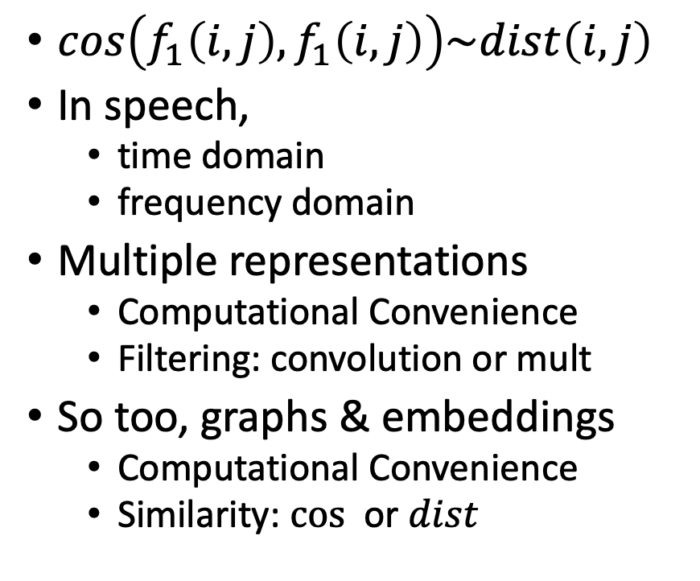
Cos-Dist: Multiple Views of Similarity
$cos\left(f_{1}\left(i, j\right),f_{1}\left(i, j\right)\right)\sim dist\left(i,j\right)$
In speech,
time domain
frequency domain
Multiple representations
Computational Convenience
Filtering: convolution or mult
So too, graphs & embeddings
Computational Convenience
Similarity: $cos⁡$ or $dist$

Slide 19
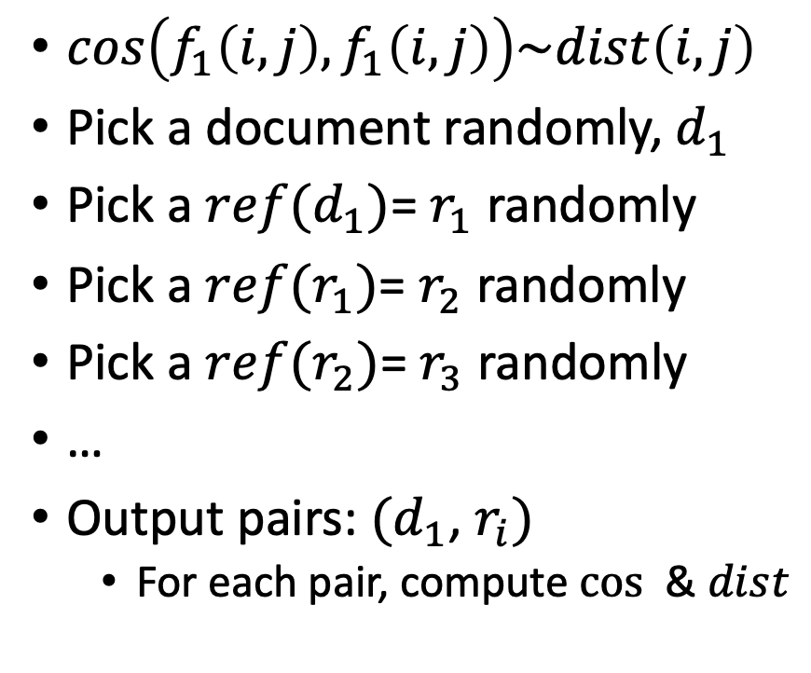
Random Walks
$cos\left(f_{1}\left(i, j\right),f_{1}\left(i, j\right)\right)\sim dist\left(i,j\right)$
Pick a document randomly, $d_{1}$
Pick a $ref(d_{1})$= $r_{1}$ randomly
Pick a $ref(r_{1})$= $r_{2}$ randomly
Pick a $ref(r_{2})$= $r_{3}$ randomly
…
Output pairs: $(d_{1}$, $r_{i})$
For each pair, compute $cos⁡$ & $dist$

Slide 20
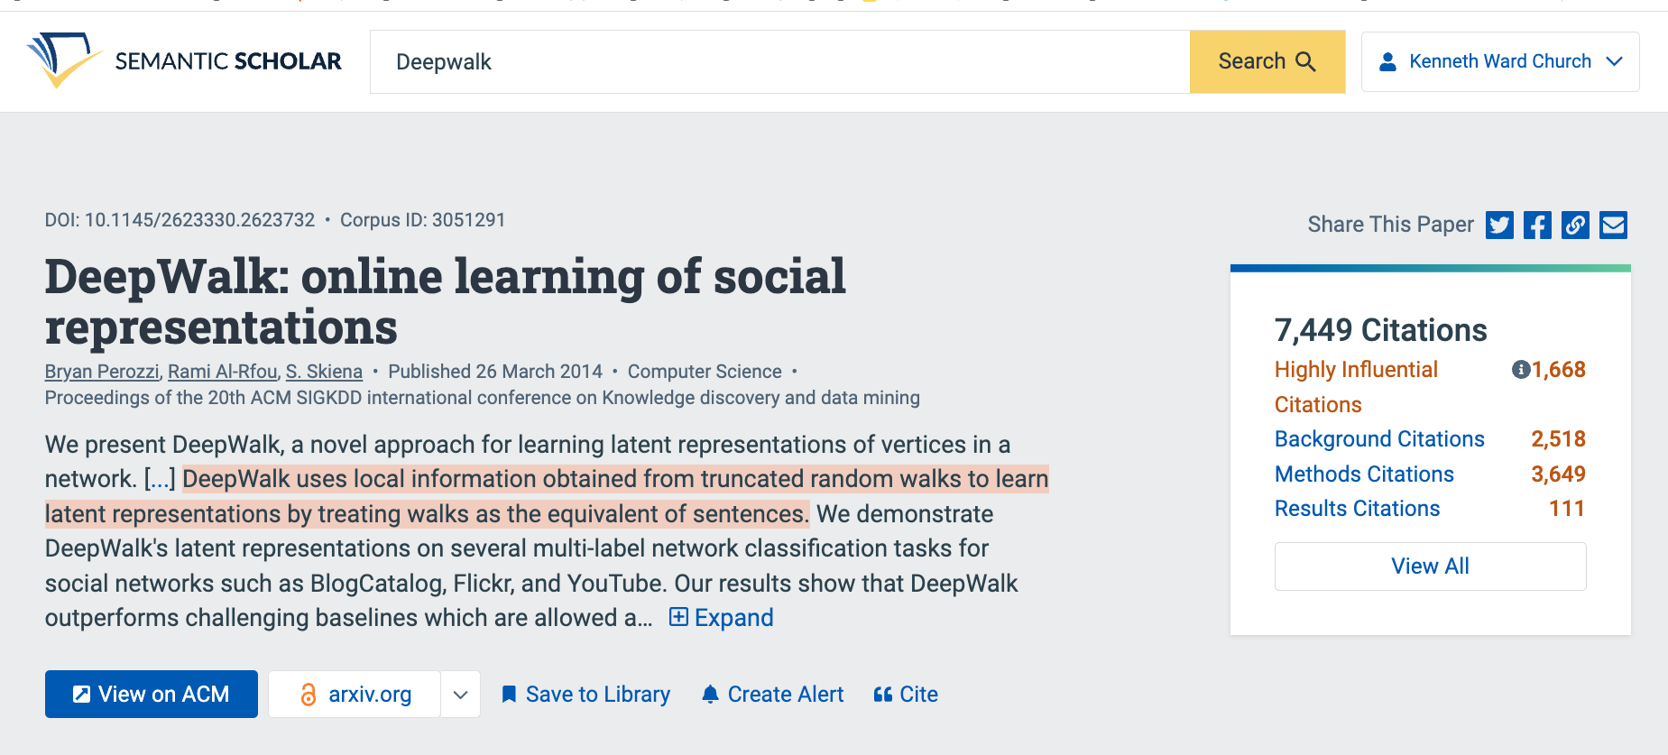
Summaries
Snippets
titles, authors, abstracts
tl;dr (too long; didn’t read)

Slide 21
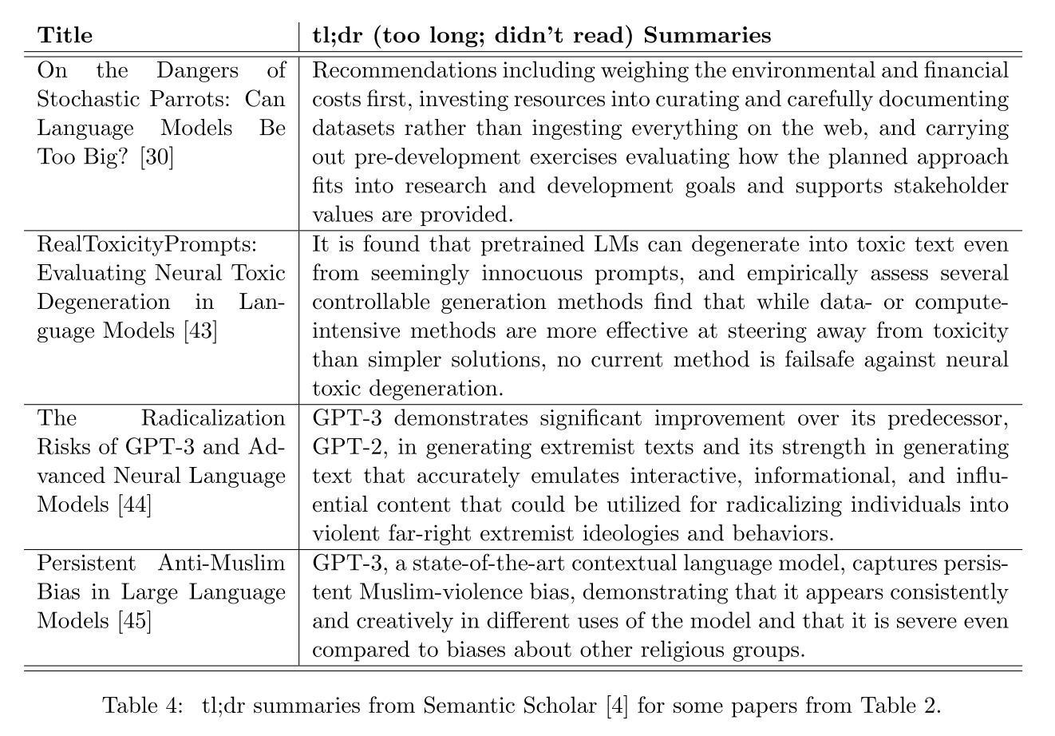

Slide 22
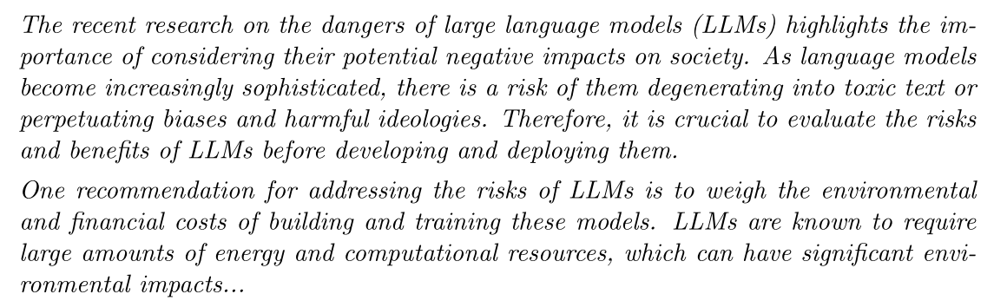
tl;dr → ChatGPT
Desiderata:
One-at-a-time → Pairwise Sim/diff

Slide 23
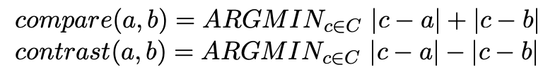
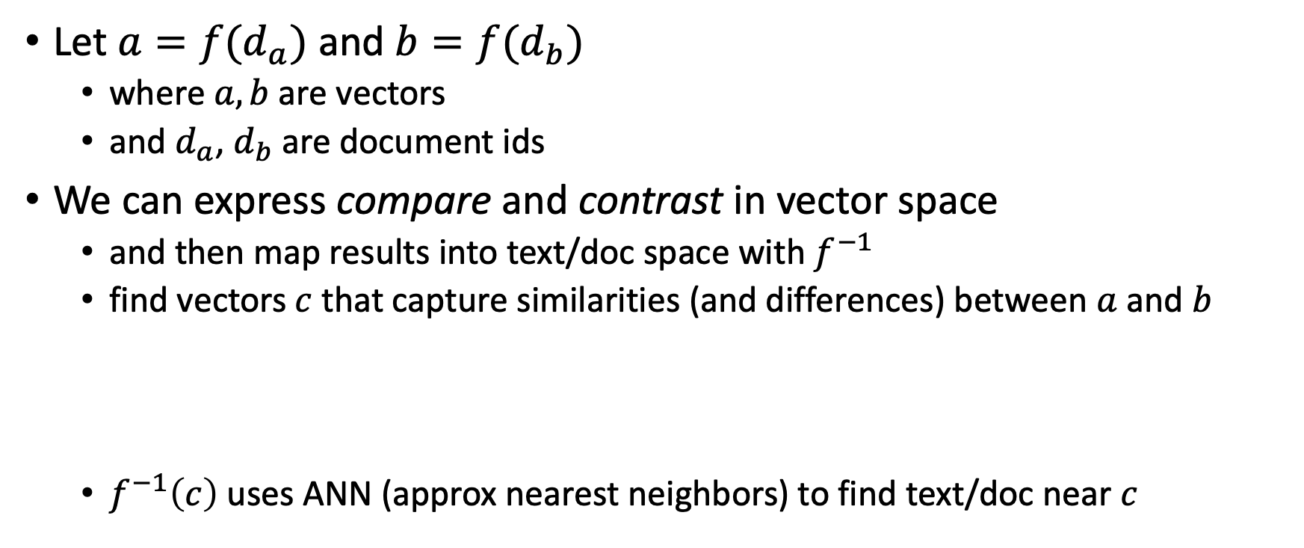
Summarization: Compare & Contrast
Let $a=f(d_{a})$ and $b=f(d_{b})$
where $a, b$are vectors
and $d_{a}$, $d_{b}$are document ids
We can express compare and contrast in vector space
and then map results into text/doc space with $f^{−1}$
find vectors $c$ that capture similarities (and differences) between $a$ and $b$
$f^{−1}\left(c\right)$ uses ANN (approx nearest neighbors) to find text/doc near $c$

Slide 24
https://github.com/kwchurch/JSALT_Better_Together
Team Page
Zoom Link
Github with source code
large datasets from Globus
Slides
Meeting Notes
Notation
Deliverables
Reading List
SciRepEval Baselines
Similar Venues
Code
Embeddings

Slide 25
Tutorial Material
Deep Nets
Pretraining
Fine-Tuning
Inference
GNNs (Graphical Neural Nets)
Linear Algebra
SVD (Singular Value Decomp)
Latent Semantic Indexing
Spectral Clustering

Slide 26
Standard 3-step recipe ACL-2022 Tutorial
Pre-training
Fine-tuning
Inference

Slide 27
Standard 3-Step Recipe
Step | Description | Time | Hardware
1
2
3 | Inference | Seconds/Minutes | 0+ GPUs
Easy

Slide 28
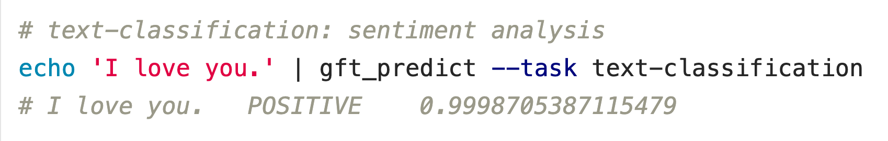


Inference: f(x) → y
Score
https://github.com/kwchurch/ACL2022_deepnets_tutorial

Slide 29



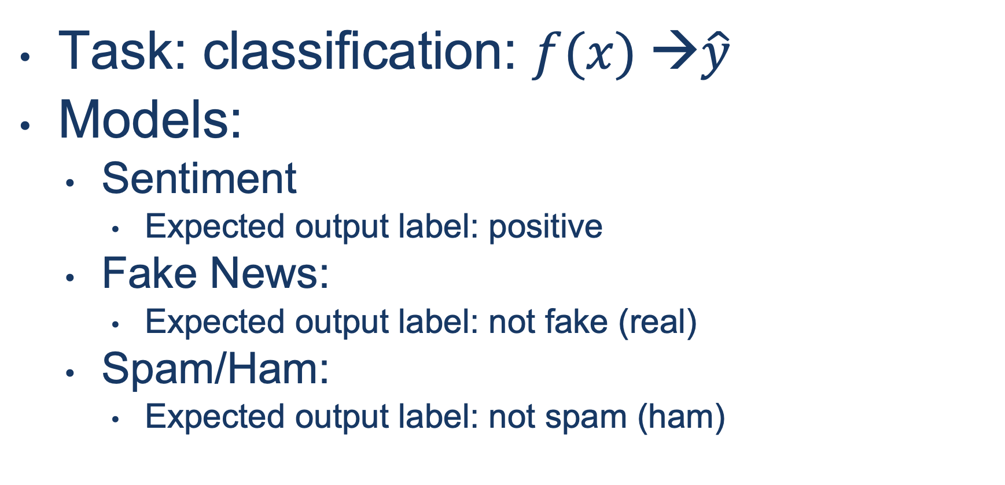
Input: I love you Output: Depends on Model: $f$
Task: classification: $f(x) →\hat{y}$
Models:
Sentiment
Expected output label: positive
Fake News:
Expected output label: not fake (real)
Spam/Ham:
Expected output label: not spam (ham)

Slide 30
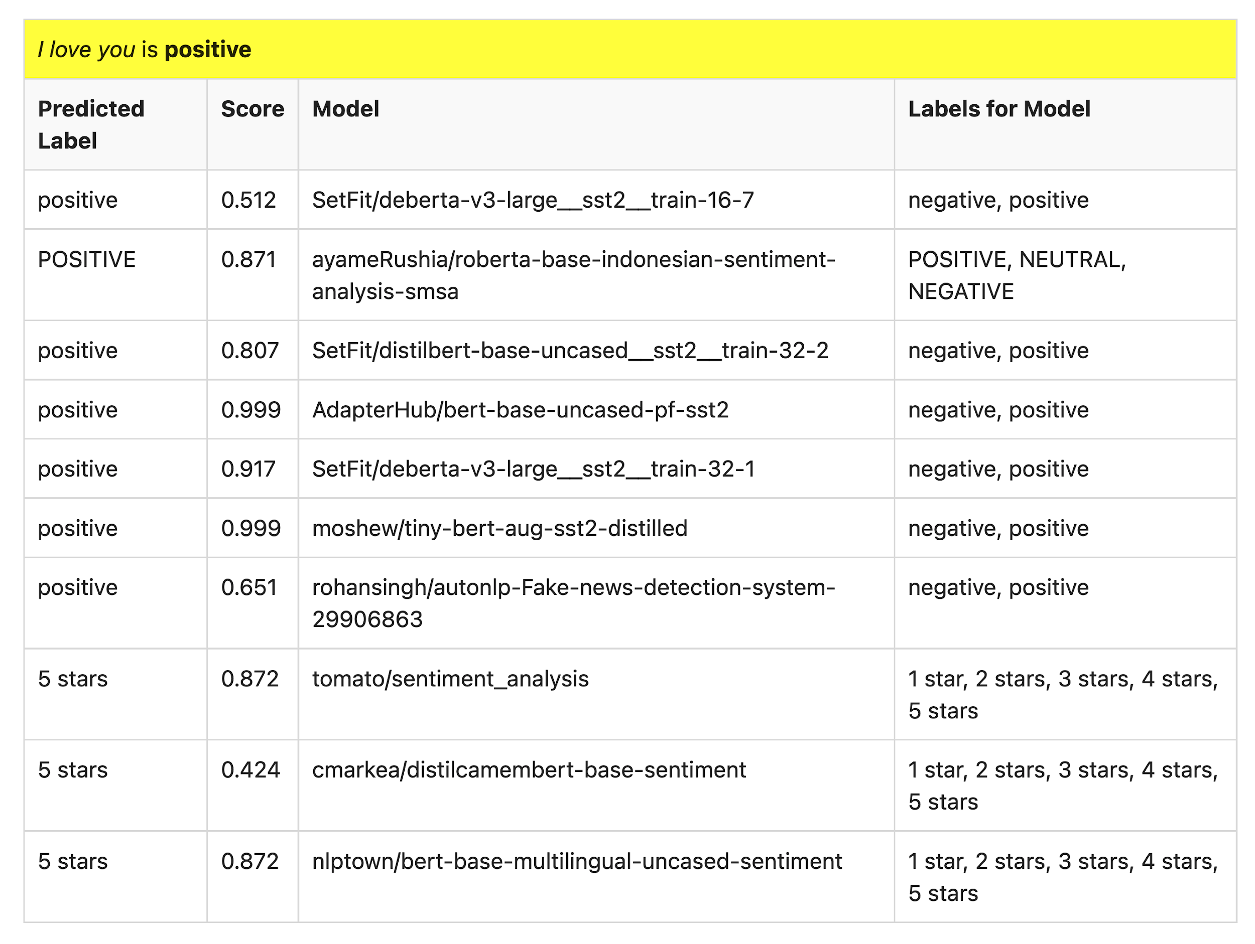
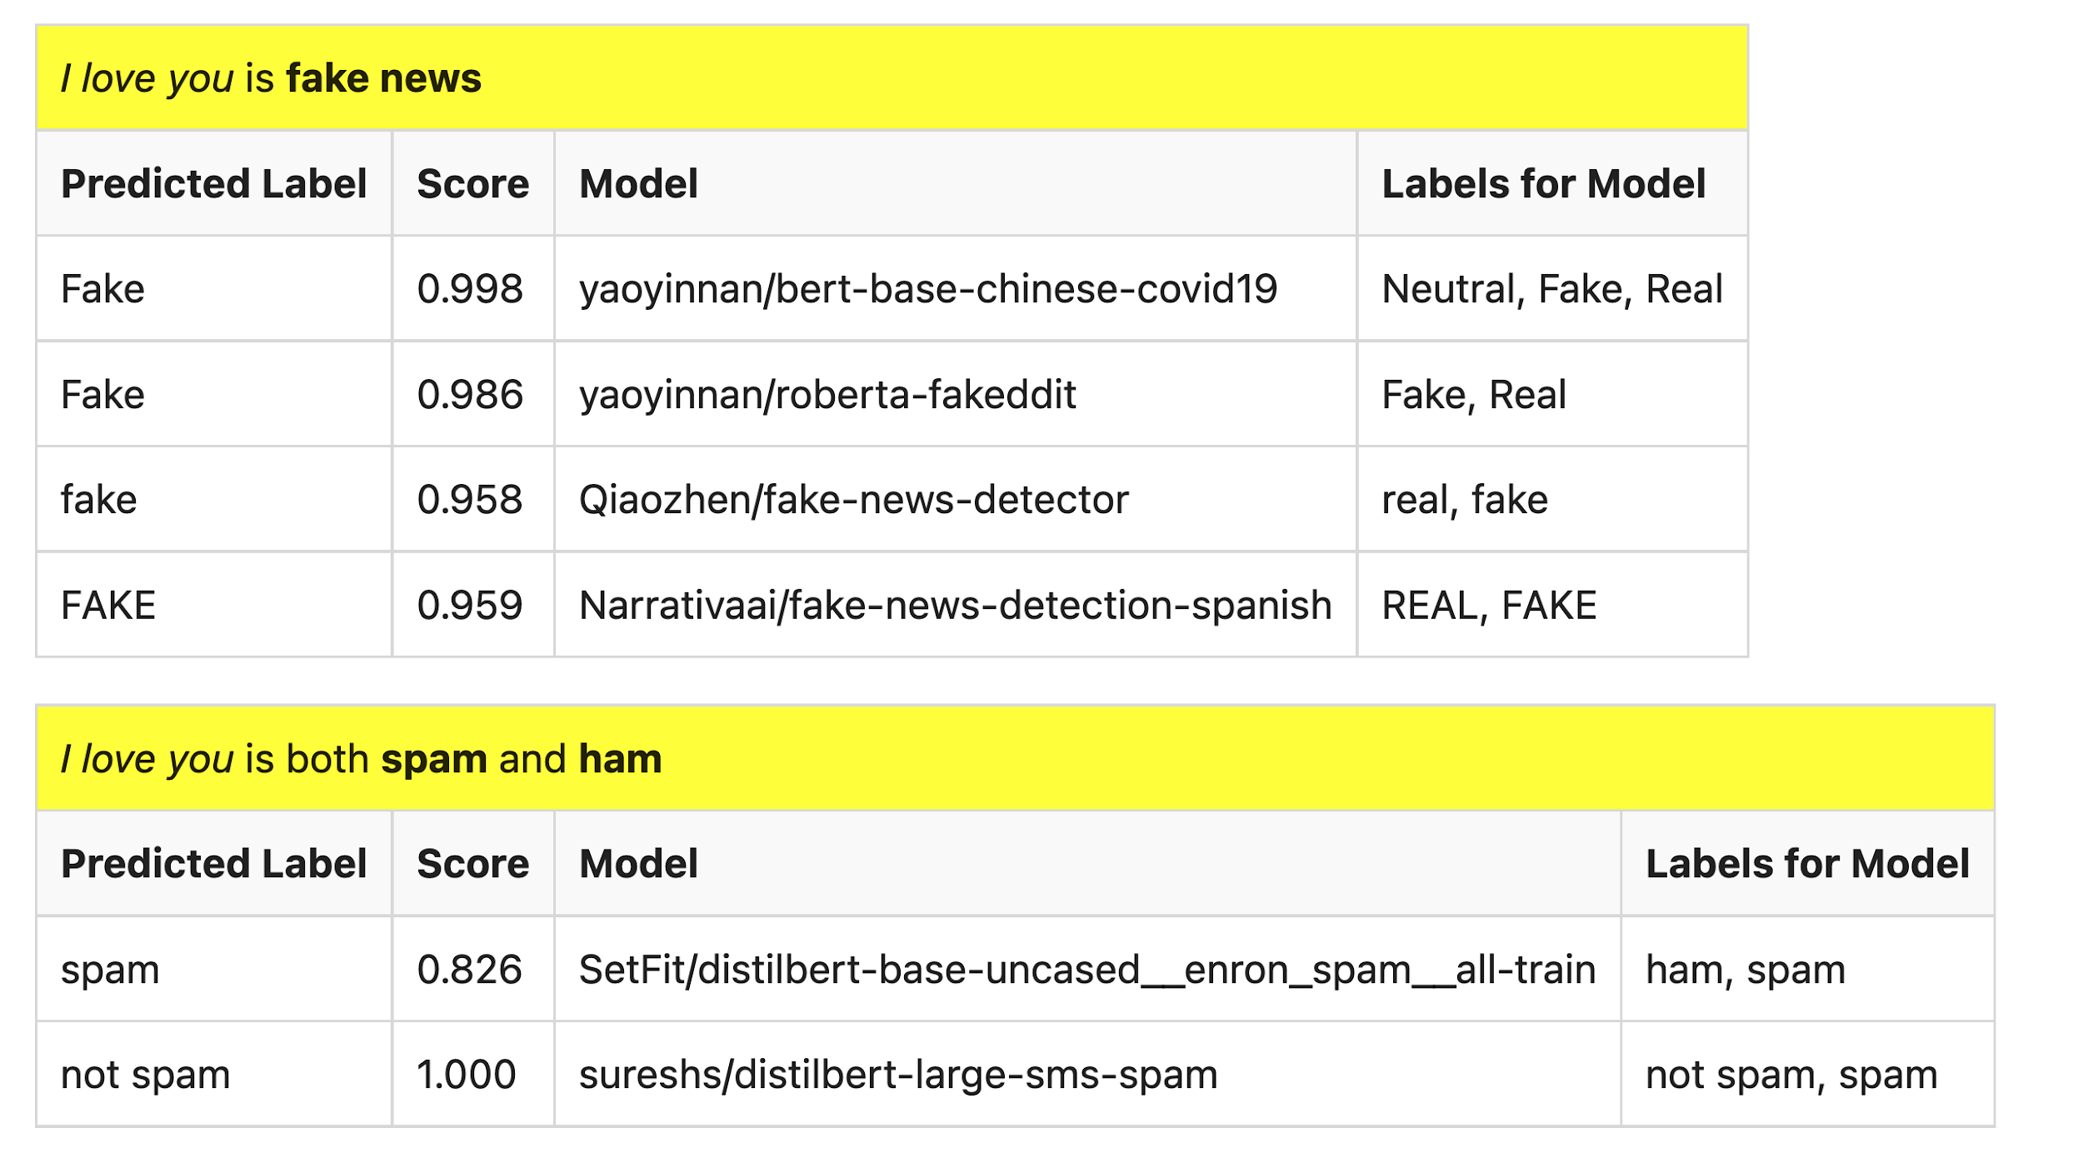
Many of these models produce reasonable results
Scores could be more confident

Slide 31

Lots of Models on Hubs (for lots of tasks)
Natural Language
Classification
Sentiment: positive/negative, 1-5 stars
Emotion classification
Hate speech classification
Guess missing word (fill-mask; cloze task)
Part of speech tagging
NER (named entity recognition)
Question Answering (SQUAD)
Entailment (GLUE)
Image Classification
Speech recognition
Machine Translation
Examples of fill-mask
echo … | gft_predict --task fill-mask
I <mask> you
miss|0.295
love|0.174
salute|0.158
I love the <mask> guy
pizza|0.035
funny|0.016
old|0.010
Examples of machine translation
echo …| gft_predict --task translation \
--model H:Helsinki-NLP/opus-mt-en-fr
I love you
Je t'aime.
2k translation models
on HuggingFace

Slide 32
Standard 3-Step Recipe
Most users should not do this themselves
Step | Description | Time | Hardware
1 | Pre-Training | Days/Weeks | Large GPU cluster
2
3 | Inference | Seconds/Minutes | 0+ GPUs

Slide 33
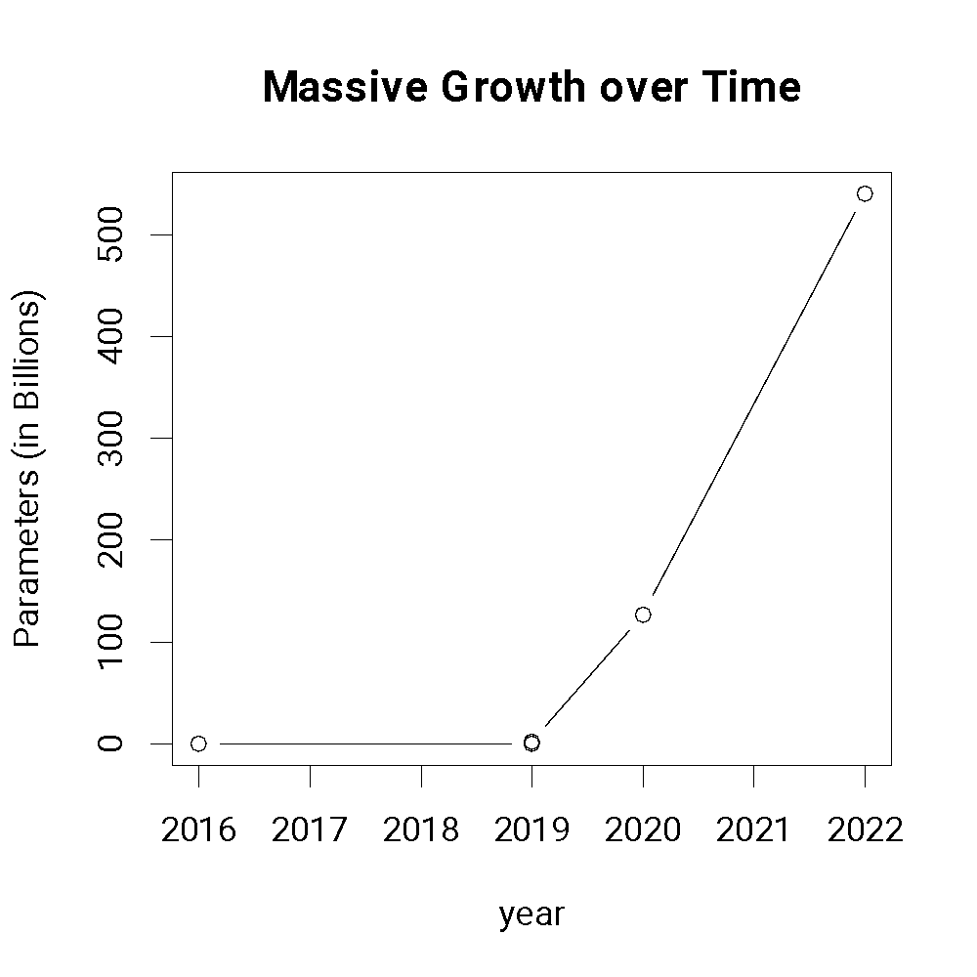
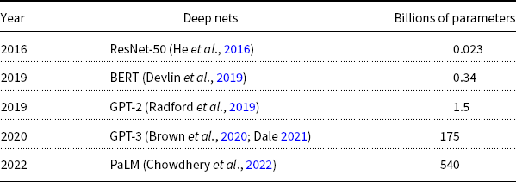
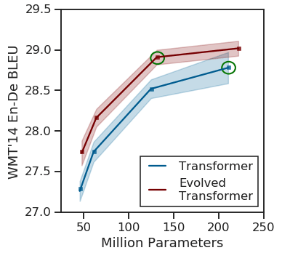
Most users should not invest in pretraining because growth (& costs) are out of control
A Rising Tide
Lifts All Boats

Slide 34
Standard 3-Step Recipe
Step | Description | Time | Hardware
1 | Pre-Training | Days/Weeks | Large GPU cluster
2 | Fine-Tuning | Hours/Days | 1+ GPUs
3 | Inference | Seconds/Minutes | 0+ GPUs
Not Hard

Slide 35

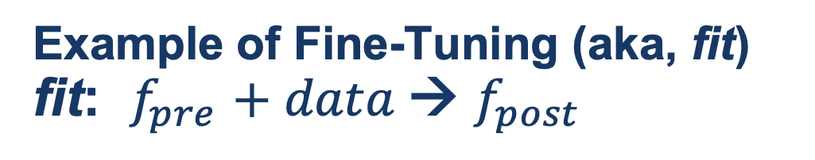
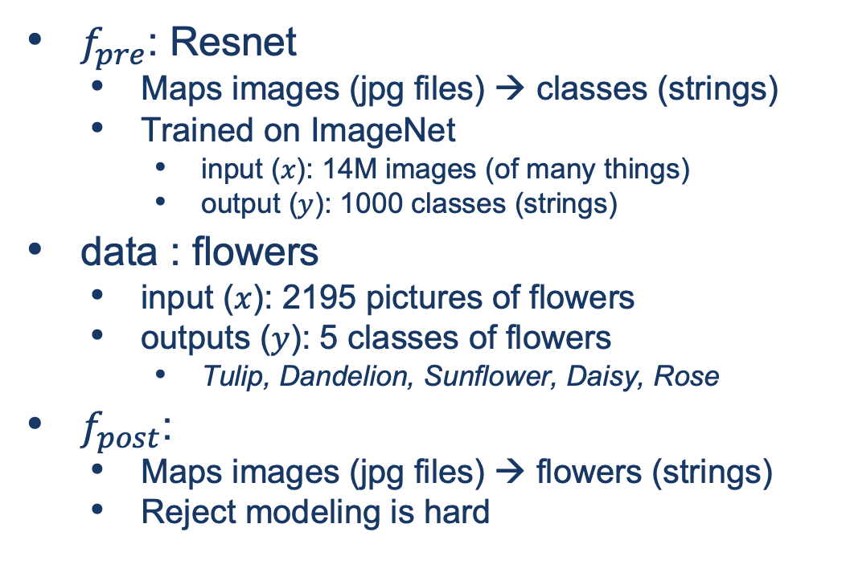
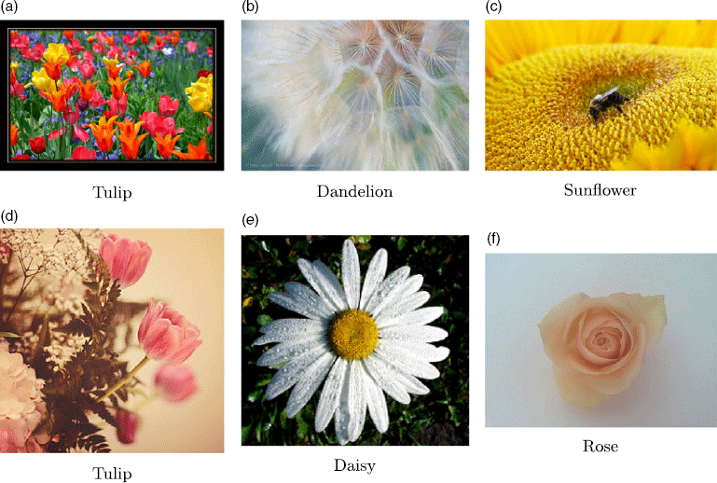
Guide Book App

Slide 36
Tutorial Background
Metcalfe’s Law
Deep Nets
Pre-training
Fine-Tuning
Inference
Specter
GNNs
Approximate Nearest Neighbors
Graphs
Random Walks
Shortest Paths
Linear Algebra
SVDs
Latent Semantic Indexing
Laplacians
ProNE

Slide 37


GNN Alternative
Black Box
GNN
Embeddings
$$M∈ℝ^{N×K}$$
Text
Context

Slide 38
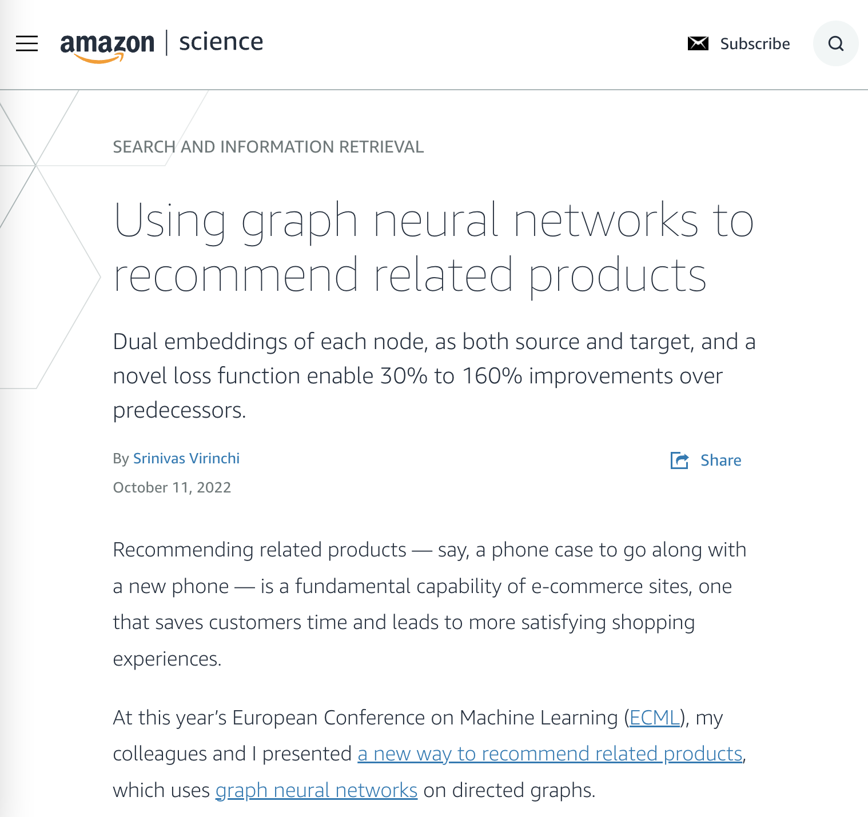
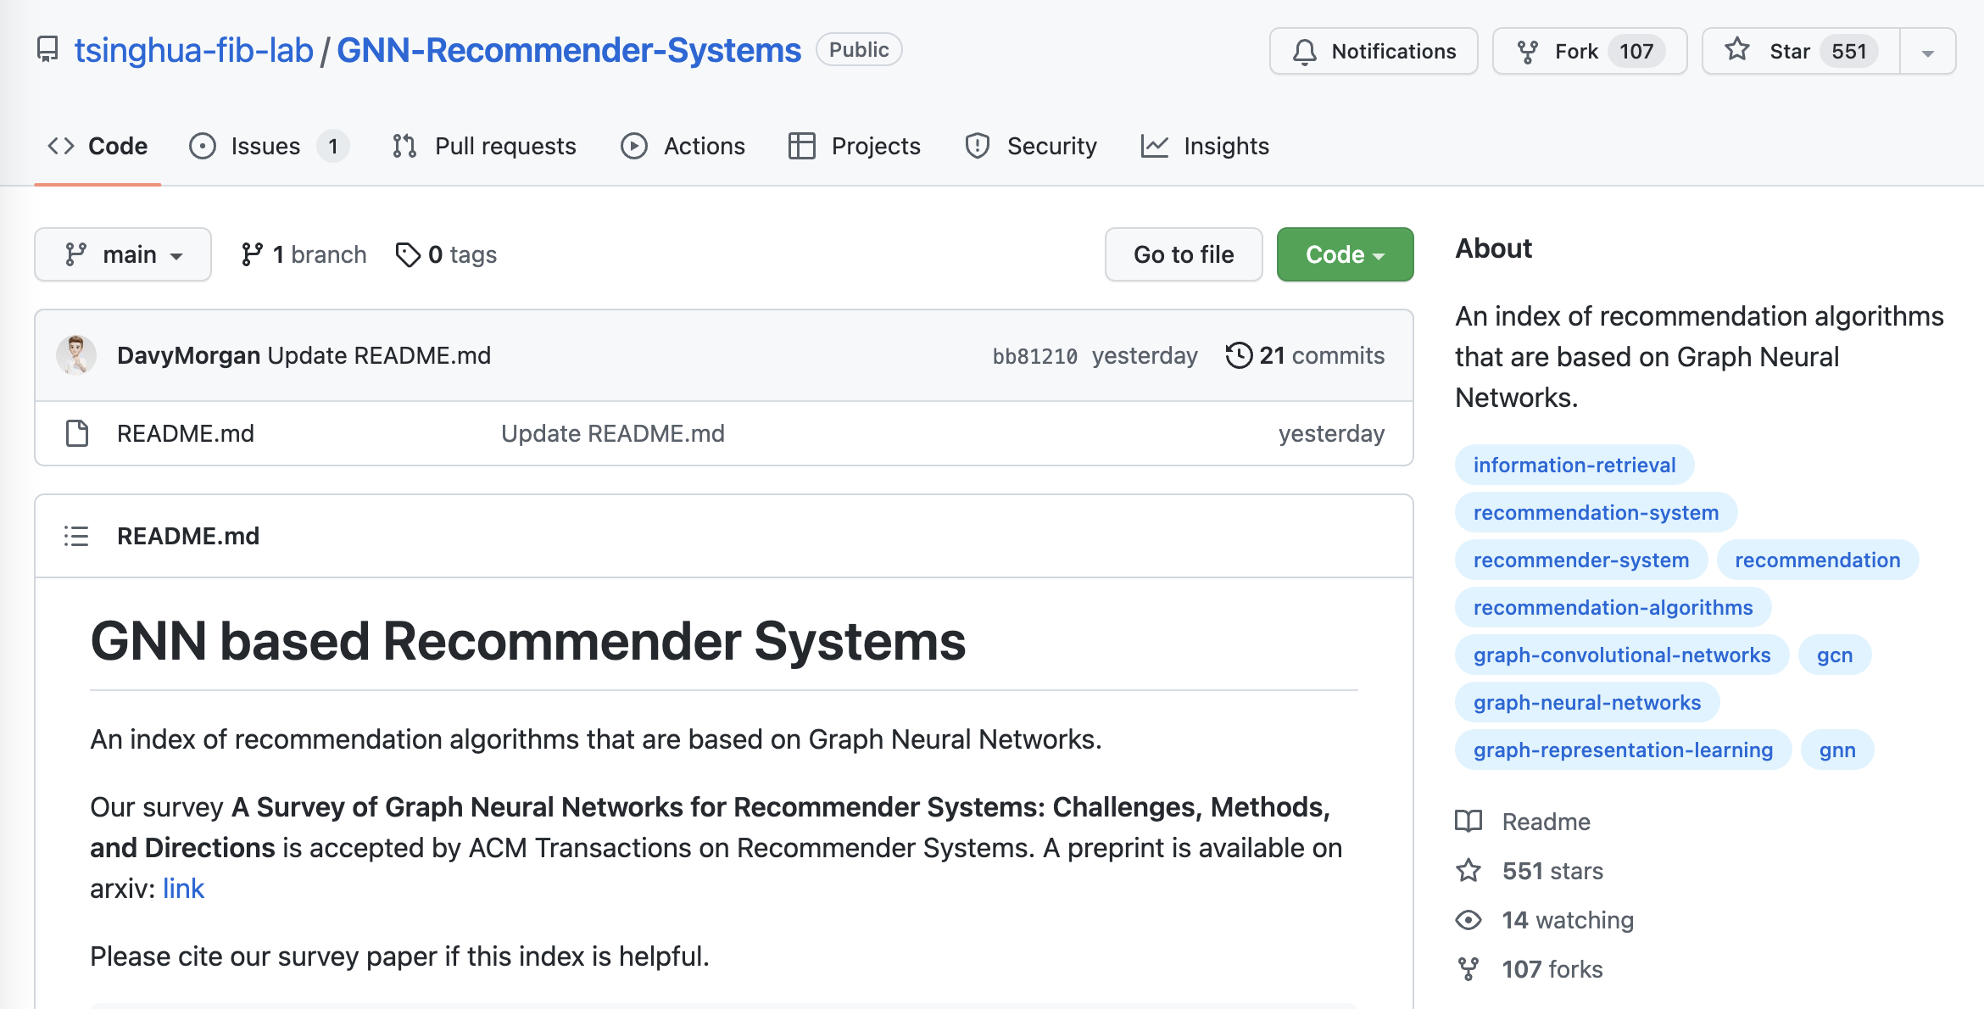
Why GNN?

Slide 39
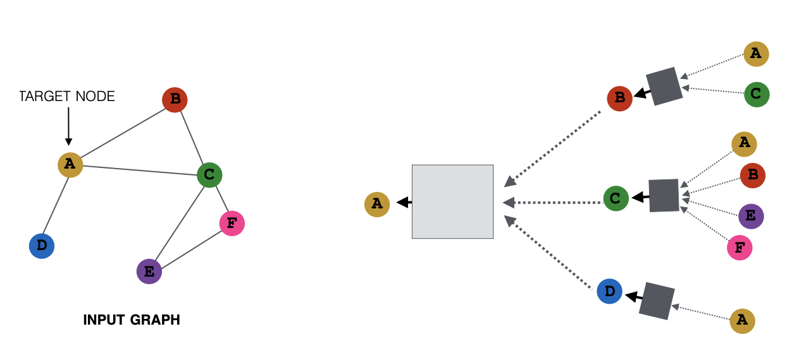
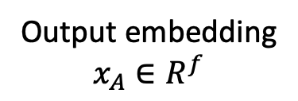
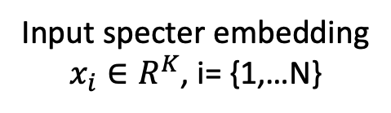
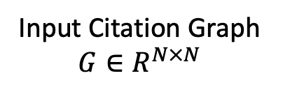
What is GNN?
Matrix Computation
Matrix Computation
Node (a paper): specter embedding
Edge: citation
Input specter embedding
$x_{i}∈R^{K}$, i= {1,…N}
Output embedding
$$x_{A}∈R^{f}$$
2-hop
Input Citation Graph
$G∈R^{N×N}$
1-hop
Ref: https://snap-stanford.github.io/cs224w-notes/machine-learning-with-networks/graph-neural-networks

Slide 40
Challenge Scale Data Parallelism v.s. Gsplit Parallelism
Proposed
Today’s data parallelism (e.g., DGL, PaGraph)
Proposed split parallelism (Gsplit)
Standard
Data parallelism – too much communication
Split parallelism (Proposed)

Slide 41
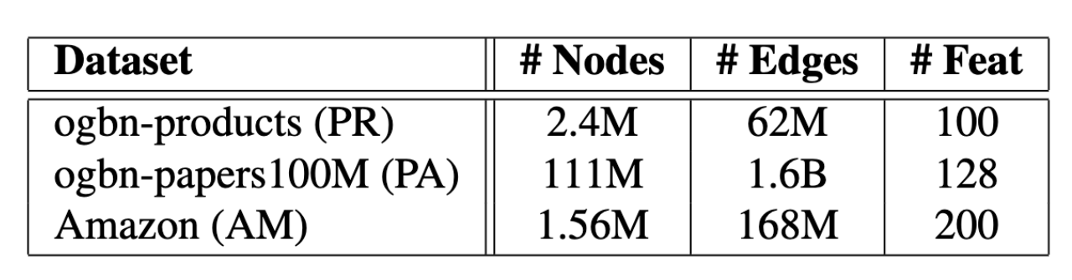
Gsplit is Faster
Today’s data parallelism (e.g., DGL, PaGraph)
Proposed split parallelism (Gsplit)

Slide 42
Tutorial Background
Metcalfe’s Law
Deep Nets
Pre-training
Fine-Tuning
Inference
Specter
GNNs
Approximate Nearest Neighbors
Graphs
Random Walks
Shortest Paths
Linear Algebra
SVDs
Latent Semantic Indexing
Laplacians
ProNE

Slide 43
Approximate Nearest Neighbors in External Memory
Kenneth Church

Slide 44
Opportunity for Publication
Well established:
Memory resident solutions (annoy)
Novelty:
External memory
mmap
Embarrassingly parallel
Standard evaluation benchmark
https://ann-benchmarks.com/
May not address advantages of proposed solution
Indexing time: small memory footprint during indexing, embarrassingly parallel
Inference time: small memory footprint, quick startup

Slide 45
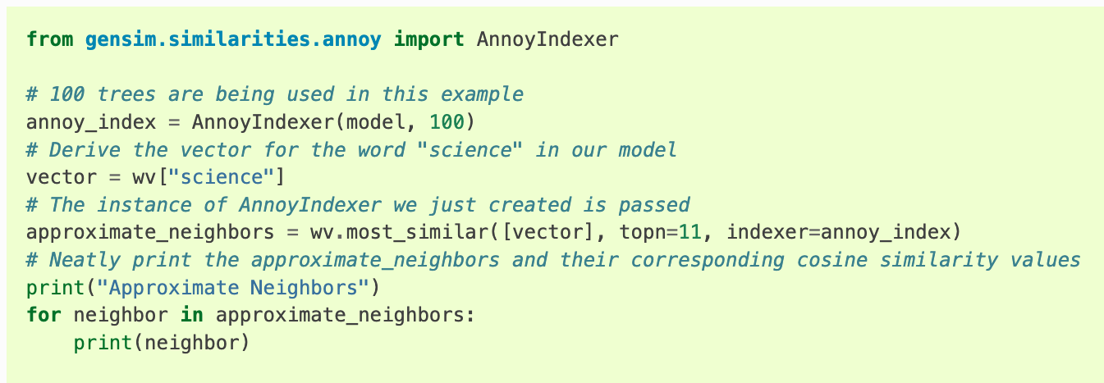
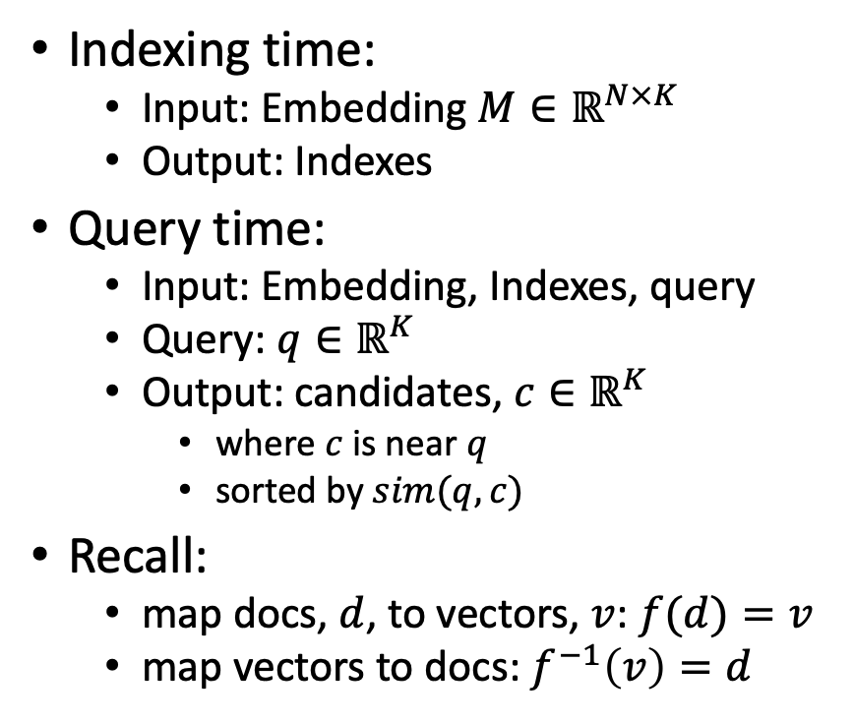
Processing with Embeddings: Annoy / Faiss Approximate Nearest Neighbors (ANN)
Indexing time:
Input: Embedding $M∈ℝ^{N×K}$
Output: Indexes
Query time:
Input: Embedding, Indexes, query
Query: $q∈ℝ^{K}$
Output: candidates, $c∈ℝ^{K}$
where $c$ is near $q$
sorted by $sim(q,c)$
Recall:
map docs, $d$, to vectors, $v$: $f(d)=v$
map vectors to docs: $f^{−1}\left(v\right)=d$
https://radimrehurek.com/gensim/auto_examples/tutorials/run_annoy.html

Slide 46
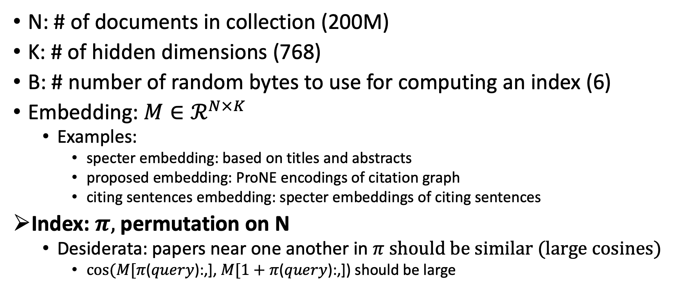
Notation
N: # of documents in collection (200M)
K: # of hidden dimensions (768)
B: # number of random bytes to use for computing an index (6)
Embedding: $M∈ℛ^{N×K}$
Examples:
specter embedding: based on titles and abstracts
proposed embedding: ProNE encodings of citation graph
citing sentences embedding: specter embeddings of citing sentences
Index: $π,$permutation on N
Desiderata: papers near one another in $π$ should be similar (large cosines)
$cos⁡(M[π$($query$):,], $M[1+π$($query$):,]) should be large

Slide 47
Memory Mapping (mmap)
Very useful function in C
floats = (float *)mmapfile(av[++i], &nfloats);
nfloats /= sizeof(float);
Loads a large file (embedding) quickly
by adding file on disk to page table (without copying the contents)
returns a pointer to the contents (and the size of object in bytes)
If you dereference a pointer to virtual memory,
there could be a page fault (if the page is not in physical memory)

Slide 48
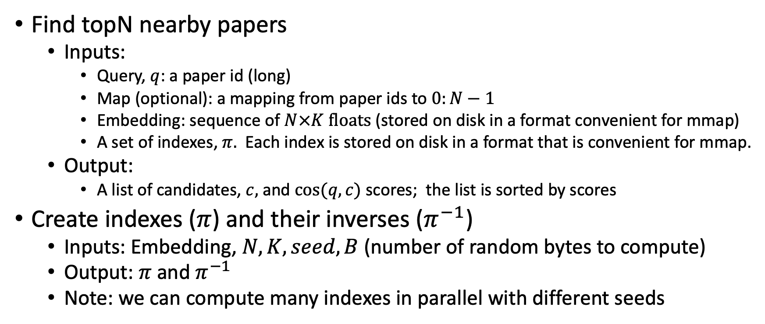
Problems to be done in external memory (Avoid loading embedding into memory)
Find topN nearby papers
Inputs:
Query, $q$: a paper id (long)
Map (optional): a mapping from paper ids to $0:N−1$
Embedding: sequence of $N×K floats$ (stored on disk in a format convenient for mmap)
A set of indexes, $π.$ Each index is stored on disk in a format that is convenient for mmap.
Output:
A list of candidates, $c,$ and $cos⁡(q,c)$ scores; the list is sorted by scores
Create indexes ($π$) and their inverses ($π^{−1}$)
Inputs: Embedding, $N, K, seed, B$(number of random bytes to compute)
Output: $π$ and $π^{−1}$
Note: we can compute many indexes in parallel with different seeds

Slide 49

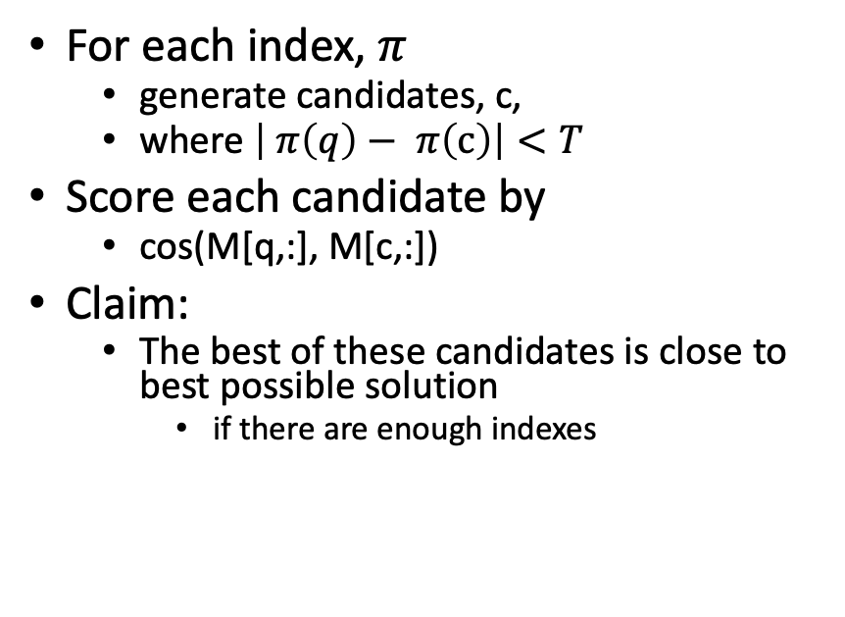
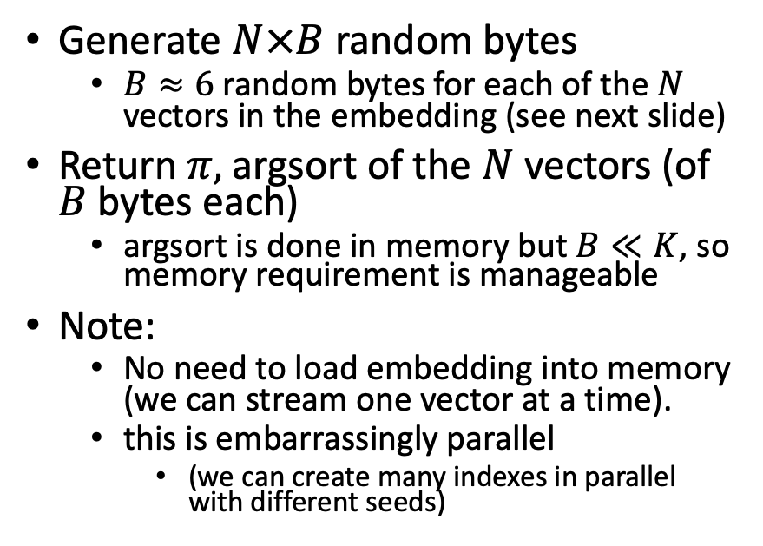
Solutions
Find topN nearby papers (easy)
Create index $π$
For each index, $π$
generate candidates, c,
where $\left| π\left(q\right)− π\left(c\right)\right|<T$
Score each candidate by
cos(M[q,:], M[c,:])
Claim:
The best of these candidates is close to best possible solution
if there are enough indexes
Generate $N×B$ random bytes
$B≈6$ random bytes for each of the $N$ vectors in the embedding (see next slide)
Return $π,$argsort of the $N$vectors (of $B$ bytes each)
argsort is done in memory but $B≪K$, so memory requirement is manageable
Note:
No need to load embedding into memory (we can stream one vector at a time).
this is embarrassingly parallel
(we can create many indexes in parallel with different seeds)

Slide 50
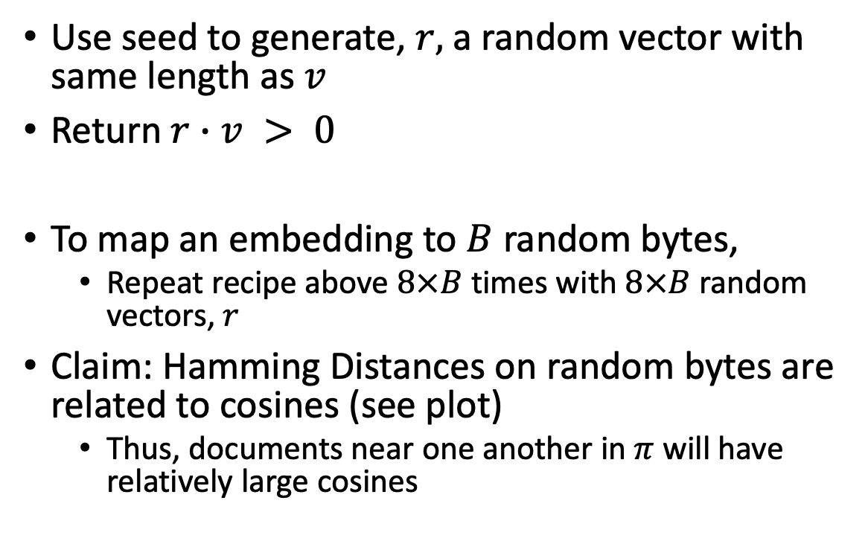

Method for mapping vector, $v$, to 1 bit
Use seed to generate, $r,$ a random vector with same length as $v$
Return $r∙v > 0$
To map an embedding to $B$ random bytes,
Repeat recipe above $8×B$ times with $8×B$ random vectors, $r$
Claim: Hamming Distances on random bytes are related to cosines (see plot)
Thus, documents near one another in $π$ will have relatively large cosines

Slide 51
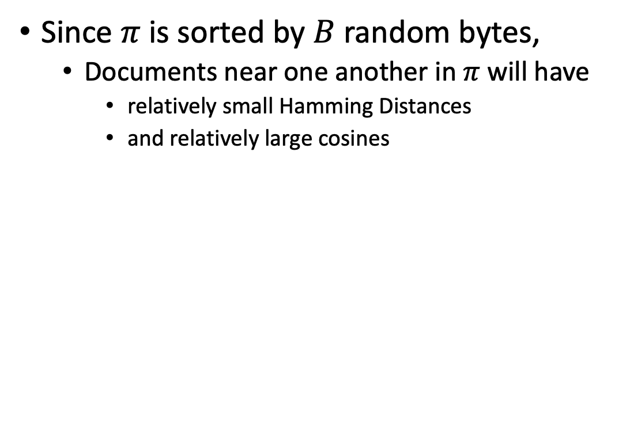

Claim: $π$ brings similar docs near one another
Since $π$ is sorted by $B$ random bytes,
Documents near one another in $π$ will have
relatively small Hamming Distances
and relatively large cosines

Slide 52


Docs near one another in $π$ are more similar
Index ($π$)
Random Baseline (without index)
Hamming Cosine N
0 0.986 245,277
1 0.925 36,590
2 0.893 37,459
3 0.865 37,306
4 0.840 35,855
5 0.818 32,184
6 0.796 27,423
7 0.776 22.319
8 0.757 17,681
9 0.738 13,138
Hamming Cosine N
0 0.999 3,955
1 0.967 879
2 0.938 1,647
3 0.912 2,239
4 0.891 5,401
5 0.883 5,853
6 0.852 9,606
7 0.826 14,087
8 0.804 22,566
9 0.782 35,174

Slide 53
Pointers to Code based on ANN
Environment variables
query=232040593
JSALTdir=/work/k.church/JSALT-2023/
JSALTsrc=/work/k.church/githubs/JSALT_Better_Together/src
specter=$JSALTdir/semantic_scholar/embeddings/specter
proposed=$JSALTdir/semantic_scholar/embeddings/proposed
Find 5 papers near query (using both Specter and Proposed)
$JSALTsrc/near.sh $query 5
Under the covers
# Find 10 papers near query (using specter embedding)
echo $query | $JSALTsrc/C/near_with_floats --dir $specter $specter/map $specter/idx.*.i > /tmp/near.specter
cut -f1,3 < /tmp/near.specter | sort -nr -u | head
# Same as above, but replace specter embedding with proposed embedding
echo $query | $JSALTsrc/C/near_with_floats --dir $proposed $proposed/idx.*.i > /tmp/near.proposed
cut -f1,3 < /tmp/near.proposed | sort -nr -u | head

Slide 54
Pointers to C Code: $JSALTsrc/C/
near_with_floats:
input query (corpusId)
output corpusIds
vector_near_with_floats:
input vector
output corpusId
pairs_to_cos:
input pairs of corpusIds
output cos scores
id_to_floats:
input corpusId
output vectors

Slide 55
Tutorial Background
Metcalfe’s Law
Deep Nets
Pre-training
Fine-Tuning
Inference
Specter
GNNs
Approximate Nearest Neighbors
Graphs
Random Walks
Shortest Paths
Linear Algebra
SVDs
Latent Semantic Indexing
Laplacians
ProNE

Slide 56
Bellcore’s Example: Bag of Words + SVD http://wordvec.colorado.edu/papers/Deerwester_1990.pdf
c1 Human machine interface for Lab ABC computer applications
c2 A survey of user opinion of computer system response time
c3 The EPS user interface management system
c4 System and human system engineering testing of EPS
c5 Relation of user-perceived response time to error measurement
m1 The generation of random, binary, unordered trees
m2 The intersection graph of paths in trees
m3 Graph minors IV: Widths of trees and well-quasi-ordering
m4 Graph minors: A survey

Slide 57
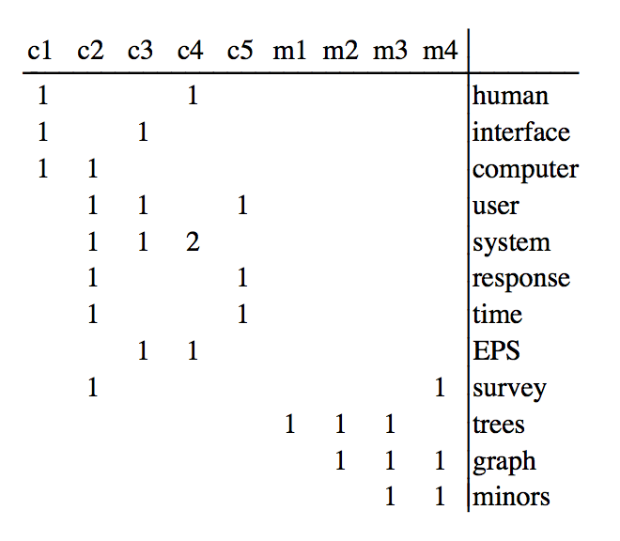
Term by Document Matrix

Slide 58
Dimension Reduction in R
"bellcore"<-
structure(.Data = c(1, 1, 1, 0, 0, 0, 0, 0, 0, 0, 0, 0, 0, 0, 1, 1, 1, 1,
1, 0, 1, 0, 0, 0, 0, 1, 0, 1, 1, 0, 0, 1, 0, 0, 0, 0, 1, 0, 0, 0, 2, 0,
0, 1, 0, 0, 0, 0, 0, 0, 0, 1, 0, 1, 1, 0, 0, 0, 0, 0, 0, 0, 0, 0, 0,
0, 0, 0, 0, 1, 0, 0, 0, 0, 0, 0, 0, 0, 0, 0, 0, 1, 1, 0, 0, 0, 0, 0,
0, 0, 0, 0, 0, 1, 1, 1, 0, 0, 0, 0, 0, 0, 0, 0, 1, 0, 1, 1),
.Dim = c(12, 9),
.Dimnames = list(c("human", "interface", "computer", "user",
"system", "response", "time", "EPS", "survey", "trees", "graph",
"minors"),
c("c1", "c2", "c3", "c4", "c5", "m1", "m2", "m3", "m4")))
b = svd(bellcore)
b2 = b$u[,1:2] %*% diag(b$d[1:2]) %*% t(b$v[,1:2])
dimnames(b2) = dimnames(bellcore)
par(mfrow=c(2,2))
plot(hclust(as.dist(-cor(bellcore))))
plot(hclust(as.dist(-cor(t(bellcore)))))
plot(hclust(as.dist(-cor(b2))))
plot(hclust(as.dist(-cor(t(b2)))))

Slide 59
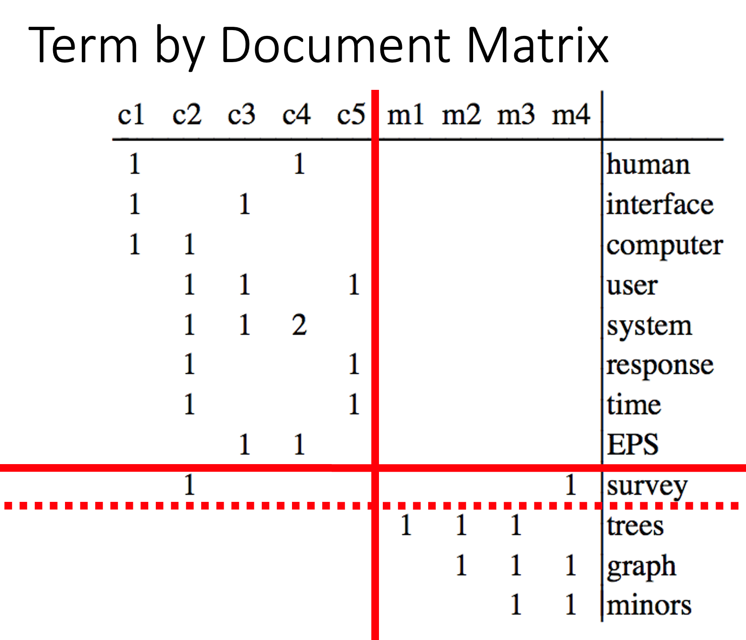
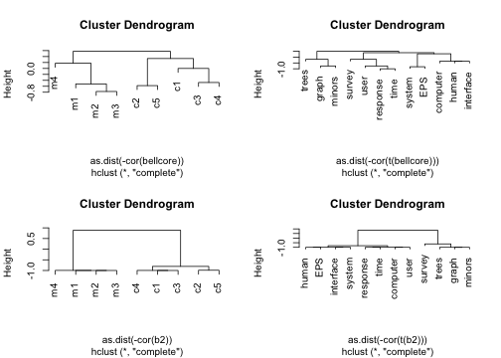
b = svd(bellcore)
b2 = b$u[,1:2] %*% diag(b$d[1:2]) %*% t(b$v[,1:2])
dimnames(b2) = dimnames(bellcore)
par(mfrow=c(2,2))
plot(hclust(as.dist(-cor(bellcore))))
plot(hclust(as.dist(-cor(t(bellcore)))))
plot(hclust(as.dist(-cor(b2))))
plot(hclust(as.dist(-cor(t(b2)))))

Slide 60

Latent concept vector space
• term
document
query
--- cosine > 0.9

Slide 61
Tutorial Background
Metcalfe’s Law
Deep Nets
Pre-training
Fine-Tuning
Inference
Specter
GNNs
Approximate Nearest Neighbors
Graphs
Random Walks
Shortest Paths
Linear Algebra
SVDs
Latent Semantic Indexing
Laplacians
ProNE

Slide 62

Random Walks
Let $A∈ℬ^{N×N}$ be a Boolean Matrix (aka, adjacency matrix)
$A\left[i,j\right]=1$ iff there is an edge from $i$ to $j$
Paths of length 0:${ A}^{0}=I$
Paths of length 1: $A$
Paths of length 2: $A^{2}$
Paths of length $n$: $A^{n}$
Transitive Closure: $\sum_{i=0}^{N}{A^{i}}$
Random Walk: $\sum_{i=0}^{N}{P^{i}}$ , where $P$ is a normalized version of graph, $G$
https://github.com/VHRanger/nodevectors/blob/master/nodevectors/prone.py
C1 = preprocessing.normalize(G, "l1")

Slide 63

Graph Laplacians https://www.cs.mcgill.ca/~wlh/grl_book/files/GRL_Book.pdf
${(I−X)}^{−1}=\sum_{i=0}^{∞}{X^{i}}$
Unnormalized Laplacians
$L = D − A$
$L$: Laplacian matrix
$A$: Adjacency matrix
$D$: Degree matrix
($N$ by $N$ diagonal matrix, with degree (fanout) of each node along diagonal)
Normalized Laplacians
$L_{sym}=D^{−\frac{1}{2}}LD^{−\frac{1}{2}}$
$L_{RW}=D^{−\frac{1}{2}}L$
Applications of Laplacians
There are connections with
Graph Cuts
Spectral Clustering
Random Walks

Slide 64


ProNE (Linear Algebra) https://github.com/VHRanger/nodevectors/blob/master/nodevectors/prone.py
Sparse
Prefactorization
Dense: N by K
Sparse
Chebyshev
Dense: N by K
Dense: N by K
Dense: N by K
Dense: N by K
Dense: N by K
Dense: N by K
Sparse
Dense: N by K

Slide 65


ProNE (Linear Algebra) https://github.com/VHRanger/nodevectors/blob/master/nodevectors/prone.py
Prefactorization
Paper

Slide 66


Paper
Chebyshev
Eqn (11)

Slide 67
Asks
Theory: Exactly what is ProNE computing?
How does the final embedding relate to distances in graph?
What is the Chebyshev approximating?
Systems: Speedups
I have separated prefactoring and each step in the loop into separate slurm jobs to support checkpointing.
We have constraints on time and memory on our cluster
Prefactoring uses less memory than Chebyshev
Because there are fewer dense matrices
Calling garbage collector can remove some large dense matrices
Are there opportunities for multi-threading, GPUs, C, cuda, tiling matrices?

Slide 68

Laplacians and Spectral Clustering https://www.cs.mcgill.ca/~wlh/grl_book/files/GRL_Book.pdf
K-means is useful on many embeddings
(Specter)

Slide 69


Topics to Cover
Clustering
K-means
sklearn
Graph Cuts, RatioCut, Diameter, Conductance
Sparse matrix packages:
scipy.sparse
networkx
https://networkx.org/documentation/stable/reference/linalg.html

Slide 70
Exercises https://github.com/kwchurch/JSALT_Better_Together
Depend on $JSALTsrc, but not $JSALTdir
Scripts for using Semantic Scholar API
Scripts for using Models from HuggingFace

Slide 71
Exercises
See https://github.com/kwchurch/JSALT_Better_Together/blob/main/doc/semantic_scholar_API.md
S2 = ``Semantic Scholar’’
Write a function that uses S2 API to input a list of ids
and output a json object for each id with:
Title
Abstract
ExternalIds
Embedding
References
Citations
Run your function on the ``DeepWalk’’ paper

Slide 72
HuggingFace Embeddings
See https://github.com/kwchurch/JSALT_Better_Together/blob/main/doc/HuggingFace_embeddings.md
Write a function that inputs ids and a model on HuggingFace
and output embeddings
the function should get the title and abstract and use that as input to the HuggingFace model
Run the model on the ``DeepWalk’’ and each of its references

Slide 73
Exercises
Project the embeddings of those references down to 2 dims
Plot those references on 2 dims

Slide 74
Replications
Tasks
Recipe
Replicate the centroid approximation plot
Replicate the cos-distance plot
Get a set of documents from HuggingFace
ds = datasets.load_dataset('allenai/scirepeval_test', 'scidocs_cite')

